Slide 1

Sportizza
“Convenient mode of booking sports arenas”
CS GROUP 19
SCS 2202
Supervisor: Dr Shiromi Arunatileka
Co-supervisor: Ishani Fonseka

Slide 2

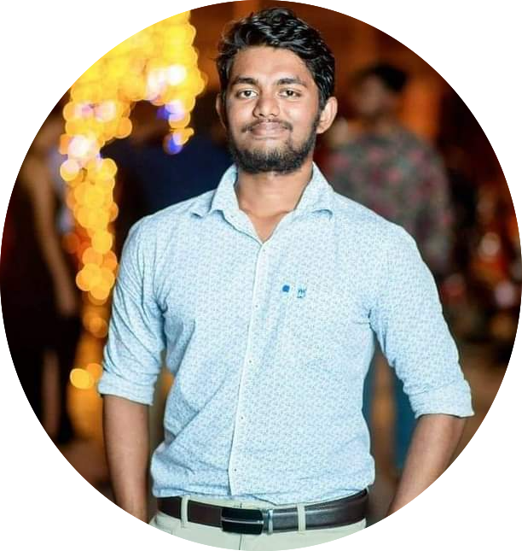

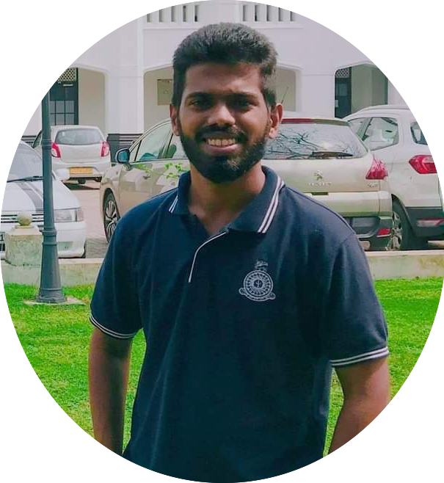
TEAM CS 19
Group members
W. L. P. MANETH
WIJETUNGA
2019/CS/194
JONATHAN. P. M.
DASS
2019/CS/028
H. B. S. BHASHITHA
RANASINGHE
2019/CS/131
K.P.D. PRASAD
LAKSHAN
2019/CS/078
GROUP 19: SPORTIZZA - PROJECT PROPOSAL

Slide 3
Introduction
GROUP 19: SPORTIZZA - PROJECT PROPOSAL

Slide 4

Customer
How many grounds did I call to check the availability?
How many calls did I made to confirm MY booking slot?
How Many days did we have to share our slots with strangers?
GROUP 19: SPORTIZZA - PROJECT PROPOSAL

Slide 5

Sports arena
How many times did outsiders used our facilities pretending to be the booking party?
How many customers didn’t pay for their booked time slot just because they couldn’t use it?
How much effort we put to keep track of our ground bookings?
GROUP 19: SPORTIZZA - PROJECT PROPOSAL

Slide 6
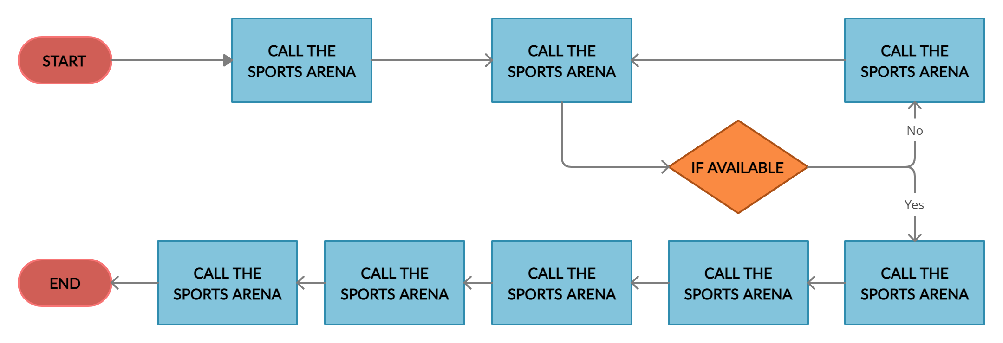
How does it work at the moment?
GROUP 19: SPORTIZZA - PROJECT PROPOSAL

Slide 7
sportizza
“An online booking platform to book sports arenas”
GROUP 19: SPORTIZZA - PROJECT PROPOSAL

Slide 8
Requirement Gathering
Frequency of visiting a sports arena
Method of making a booking
Avg. no. of calls made per booking
GROUP 19: SPORTIZZA - PROJECT PROPOSAL

Slide 9
Occupancy Rates
 | Mercantile Basketball Court | CR7 Futsal Club | Royal Sports Complex-Indoor
Occupancy rate on weekends (From 8am-10pm) | 71% | 71% | 85%
Occupancy rate on weekdays (From 4pm-10pm) | 80% | 100% | 80%
Preferable features to have on the proposed platform
GROUP 19: SPORTIZZA - PROJECT PROPOSAL

Slide 10



Other methods
GROUP 19: SPORTIZZA - PROJECT PROPOSAL

Slide 11
Project Scope
Sports equipment merchandising.
Booking time slots with coaches.
User Registration and Authentication.
Search for sports arenas/ time-slots.
Make bookings.
Cancel bookings.
Ratings for sports arenas.
Share bookings.
View bookings.
Payment processing.
Sports arena listing in the platform.
Analytics generation for sports arenas.
Notifications to customers.
Discounts on booking time slots.
Booking rescheduling.
Messaging module for customers & sports arenas.
Advertising of sports events (tournaments).
GROUP 19: SPORTIZZA - PROJECT PROPOSAL

Slide 12
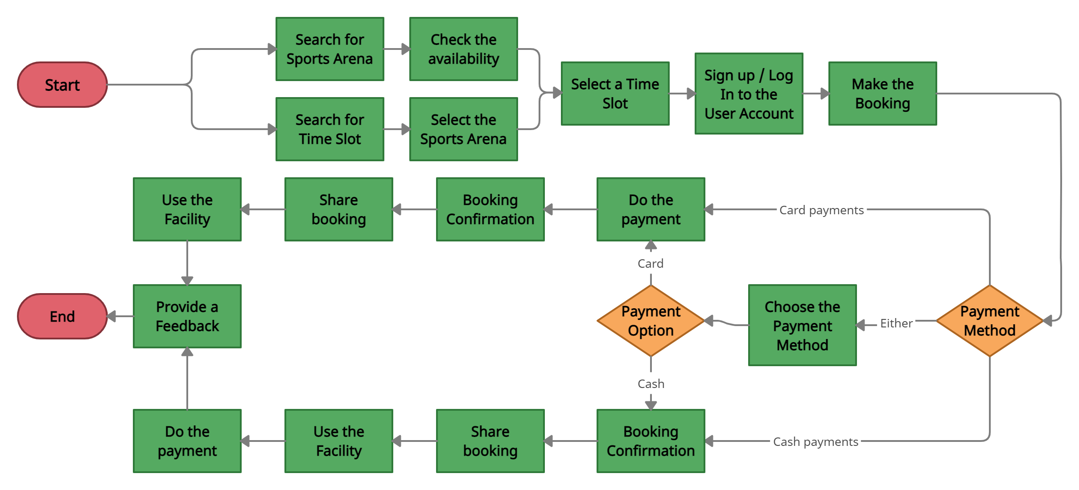
How does it work with our solution?
GROUP 19: SPORTIZZA - PROJECT PROPOSAL

Slide 13
Any Similar systems?
“None is available in Sri lanka!”
GROUP 19: SPORTIZZA - PROJECT PROPOSAL

Slide 14


Business model
5 % Royalty Fee
Zero Fee
Sportizza
Advertising Fee
Customer
Sports arena
*Scalable with merchants & event organisers of sports events
GROUP 19: SPORTIZZA - PROJECT PROPOSAL

Slide 15
Requirement Analysis
GROUP 19: SPORTIZZA - PROJECT PROPOSAL

Slide 16






User identification
01
03
04
06
Visitor
Booking handling staff
Location manager
02
05
Admin
customer
Administration staff
GROUP 19: SPORTIZZA - PROJECT PROPOSAL

Slide 17
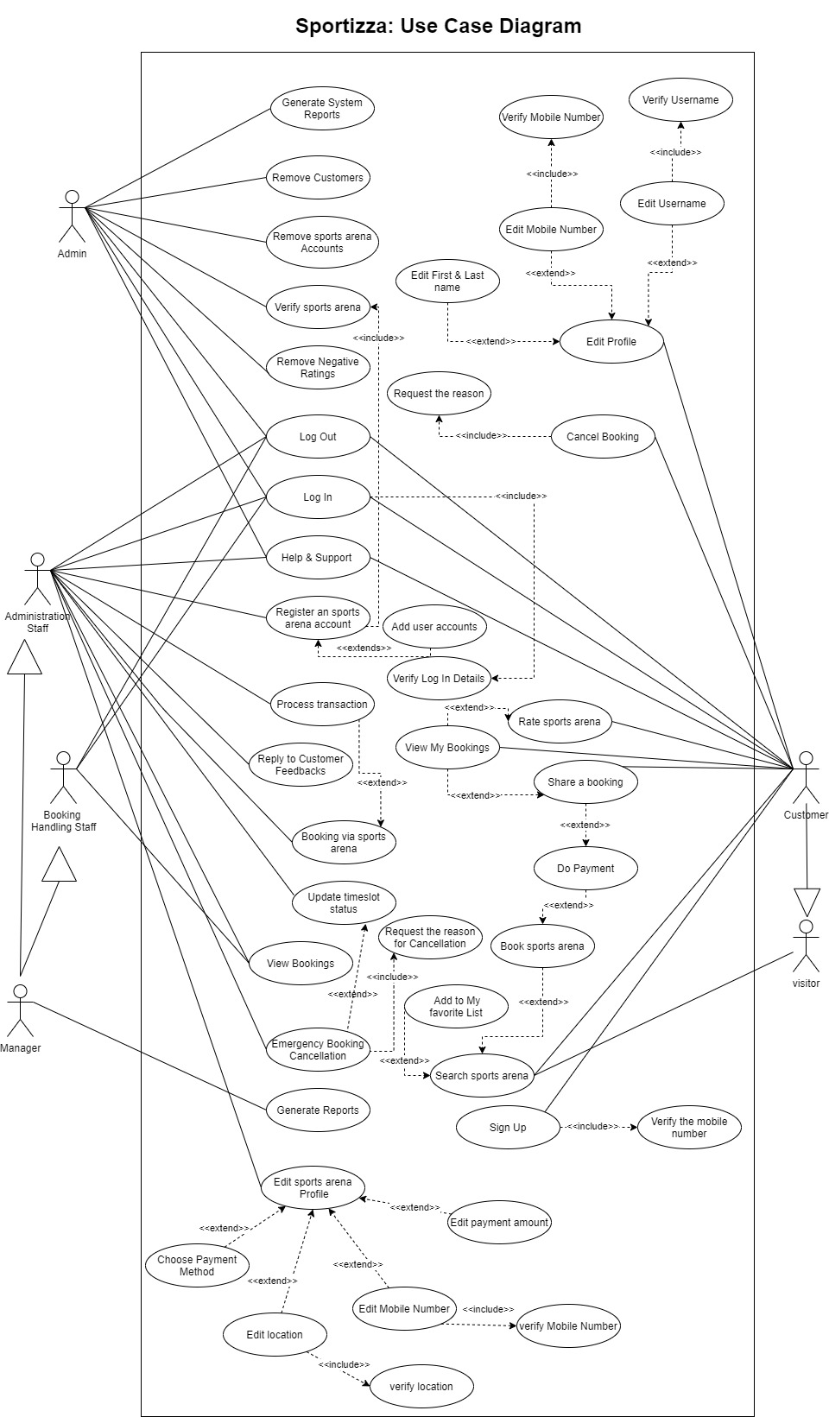
Use case diagram
GROUP 19: SPORTIZZA - PROJECT PROPOSAL

Slide 18
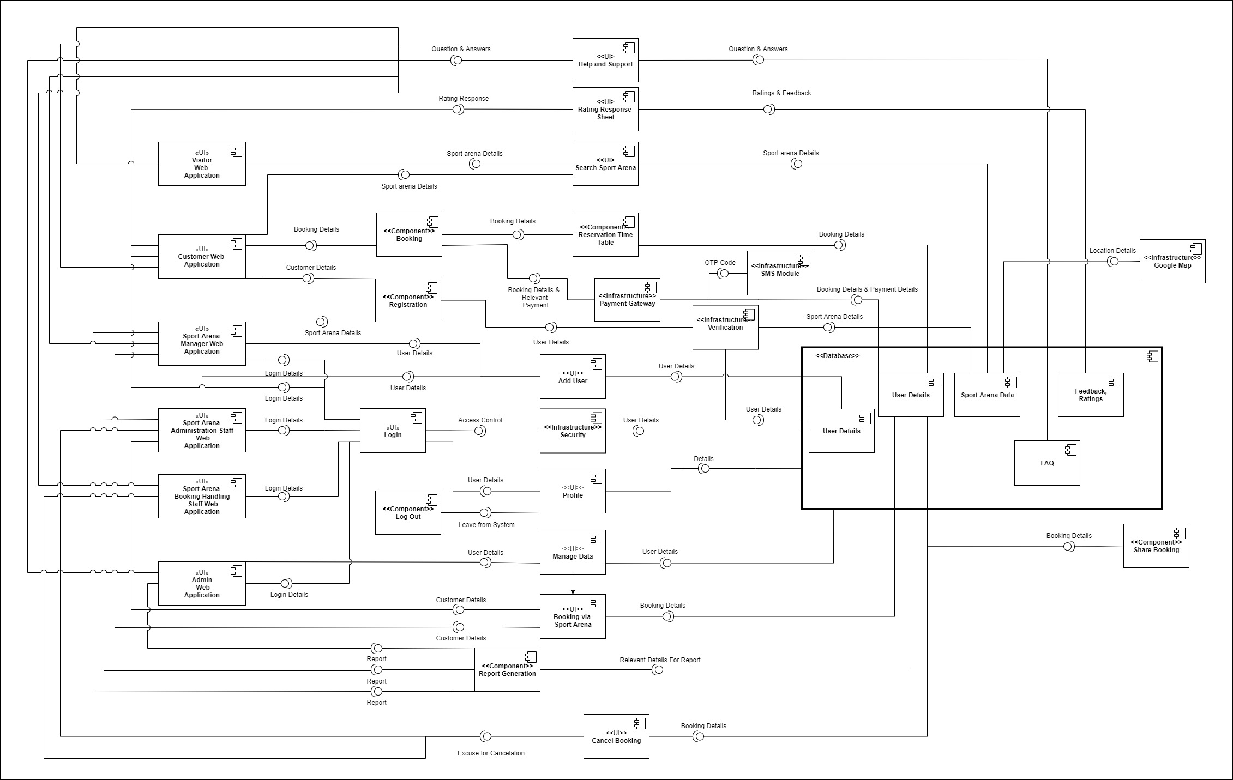
Component diagram
(high-level architecture)
GROUP 19: SPORTIZZA - PROJECT PROPOSAL

Slide 19



SOFTWARE ARCHITECTURE SUMMARY
1. User interacts with a view
2. View alerts controller of a particular event.
3. Controller updates Model
4. Model alerts view that it has changed.
5. View grabs model data and update itself.
GROUP 19: SPORTIZZA - PROJECT PROPOSAL

Slide 20
Non-functional requirements
01
Security
04
Performance
02
Availability
05
Testability
03
Modifiability
06
usability
GROUP 19: SPORTIZZA - PROJECT PROPOSAL
GROUP 19: SPORTIZZA - PROJECT PROPOSAL

Slide 21
Technical feasibility
IDEs are free and open source.
Laptops and desktops are owned by the group members.
Workbox for offline caching.
Google Light-house to audit the system.
Within our knowledge boundary.
GROUP 19: SPORTIZZA - PROJECT PROPOSAL

Slide 22
Operational feasibility
Basic Requirements:
Basic English & IT literacy.
A device with an Internet connection.
Preferably a Personal computer or a laptop for the sports arena’s manager and administration-staff.
Affordability
5 % Royalty Fee
Customer
Sports arena
Zero Fee
Advertising Fee
GROUP 19: SPORTIZZA - PROJECT PROPOSAL

Slide 23
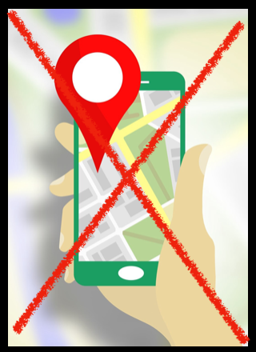
Legal & ethical feasibility
Sensitive data- GDPR laws.
Hierarchical based login mechanism.
Secure Online payments 3rd party Application.
Credit Card information are not stored.
Customer locations are not tracked.
GROUP 19: SPORTIZZA - PROJECT PROPOSAL

Slide 24
Economic feasibility
PayHere sandbox (In the development stage).
Amazon Web Services’ Free Tier- Hosting services.
TEXTIT.BIZ cost 69cents per a SMS- SMS module.
All other IDEs and softwares used for development are freely available.
GROUP 19: SPORTIZZA - PROJECT PROPOSAL

Slide 25
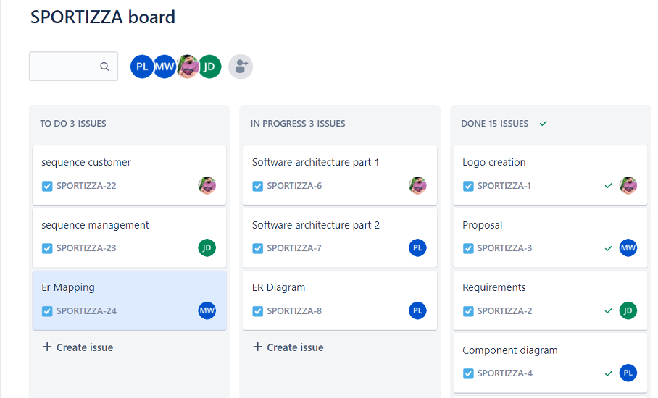
Scheduling feasibility
Waterfall
model
4 members * 10 hours per week = 40 hours per week
40 hours/week *30 weeks = 1200 hours
Risk buffer = 24o hours
total budgeted time = 1440 hours
*The above time is only a budgeted time and always there can be favourable and adverse variances
GROUP 19: SPORTIZZA - PROJECT PROPOSAL
GROUP 19: SPORTIZZA - PROJECT PROPOSAL

Slide 26
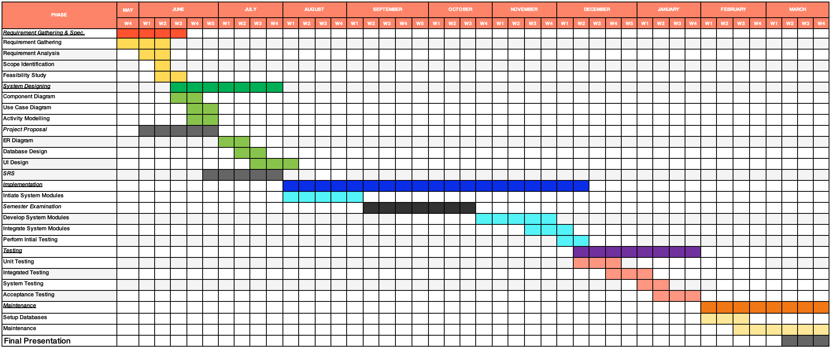
Gantt chart
GROUP 19: SPORTIZZA - PROJECT PROPOSAL
GROUP 19: SPORTIZZA - PROJECT PROPOSAL

Slide 27
Limitations & constraints
Cash Payments aren’t handled via the platform.
Booking rescheduling is not possible.
One sports arena containing multiple categories of SPORTS facilities have to make separate accounts for each category.
Government controlled sports arenas -might not get registered in sportizza.
GROUP 19: SPORTIZZA - PROJECT PROPOSAL
GROUP 19: SPORTIZZA - PROJECT PROPOSAL

Slide 28





Frontend, backend & database management
Front end:
Back end & database:
GROUP 19: SPORTIZZA - PROJECT PROPOSAL
GROUP 19: SPORTIZZA - PROJECT PROPOSAL

Slide 29


Other technologies:
Modules:
Other tools:
Other softwares:
GROUP 19: SPORTIZZA - PROJECT PROPOSAL

Slide 30
Questions?

Slide 31
Actors
03
04
05
Location manager
Booking handling staff
Administration staff
Register for an account
Login/Logout
Edit sports arena profile
Generate reports
Choose payment method
Reply to customer feedbacks and queries
Booking slots manually
View bookings
Emergency booking cancellations
Login/Logout
View bookings
Register for an account
Login/Logout
Edit profile details
Choose payment method
Reply to customer feedbacks and queries
View bookings
Booking Slots manually
Emergency booking cancellations
GROUP 19: SPORTIZZA - PROJECT PROPOSAL

Slide 32
Actors
02
Signup
Login/ Logout
Edit profile details
Search for sports arenas
Book sports arena
Do a payment
Share booking via social media
Rate sports arenas and provide reviews
Create my sports arenas list
Cancel booking
View my bookings
Ask help/ support desk
01
Visitor
customer
Search for sports arenas
Ask help/ support desk
GROUP 19: SPORTIZZA - PROJECT PROPOSAL

Slide 33
Actors
06
Login/Logout
Verify sports arenas for listing
Remove sports arenas
Remove customers
Remove negative feedbacks after assurance by the sports arena
Help & support
Generate System Reports
Admin
GROUP 19: SPORTIZZA - PROJECT PROPOSAL

Slide 34
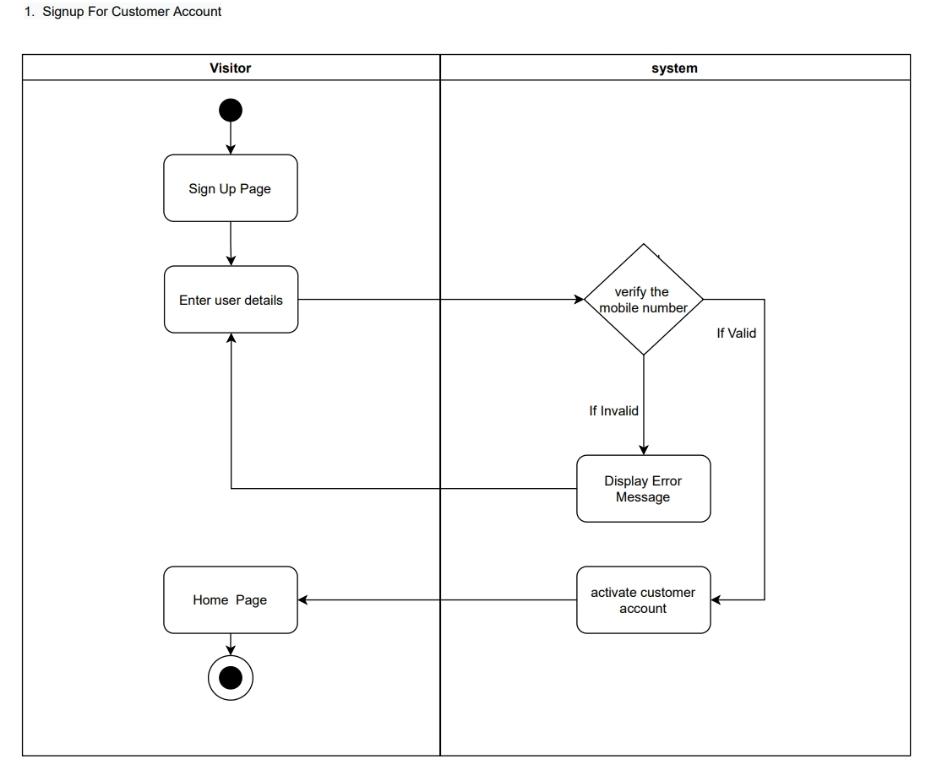
Activity diagrams
GROUP 19: SPORTIZZA - PROJECT PROPOSAL

Slide 35
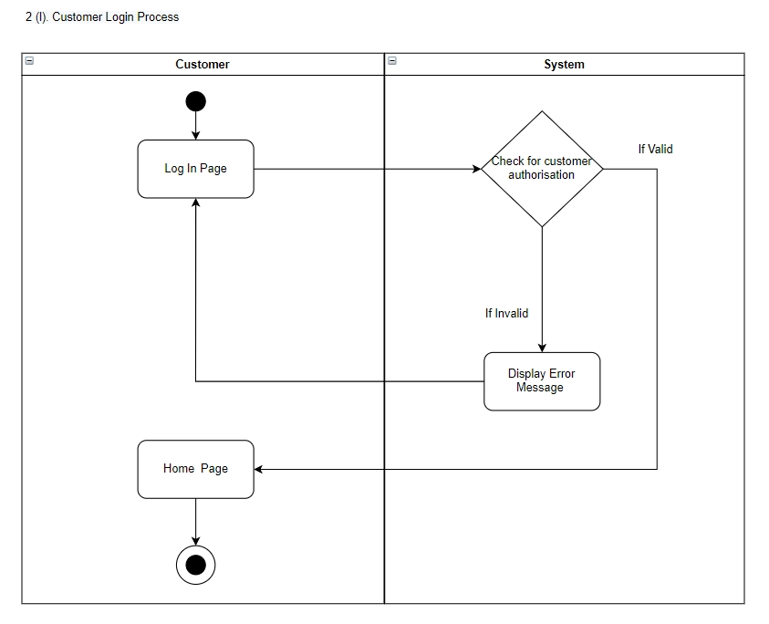
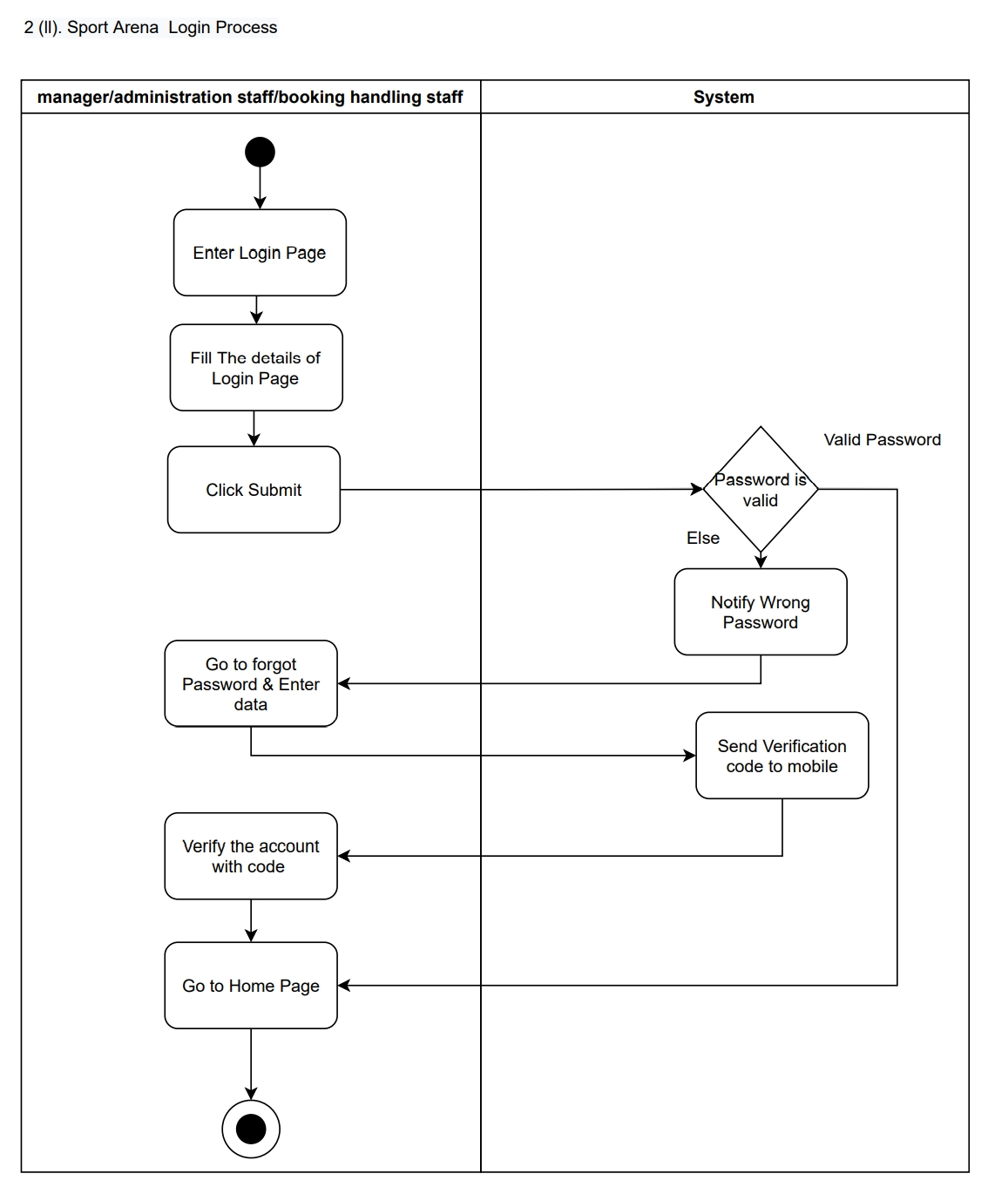
GROUP 19: SPORTIZZA - PROJECT PROPOSAL

Slide 36
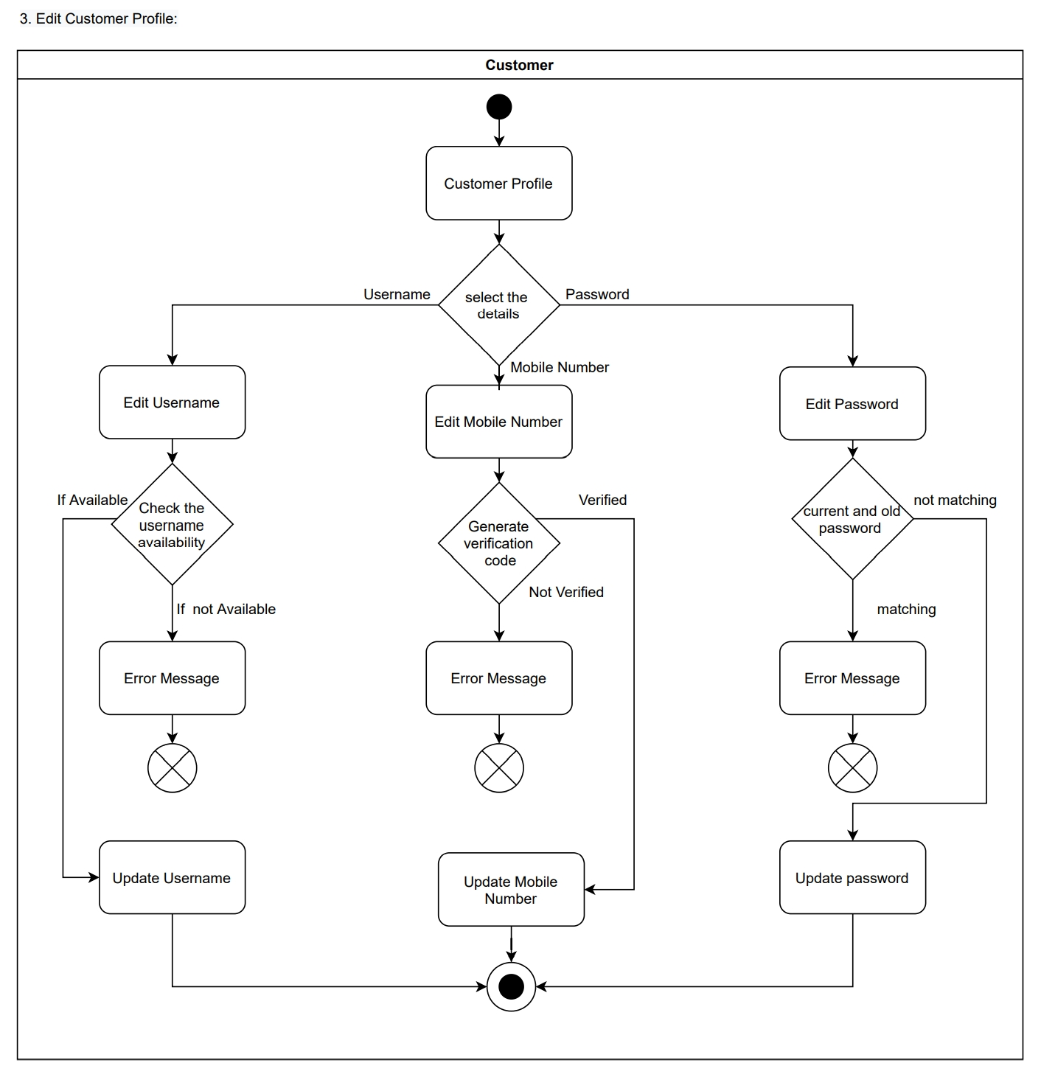
GROUP 19: SPORTIZZA - PROJECT PROPOSAL

Slide 37
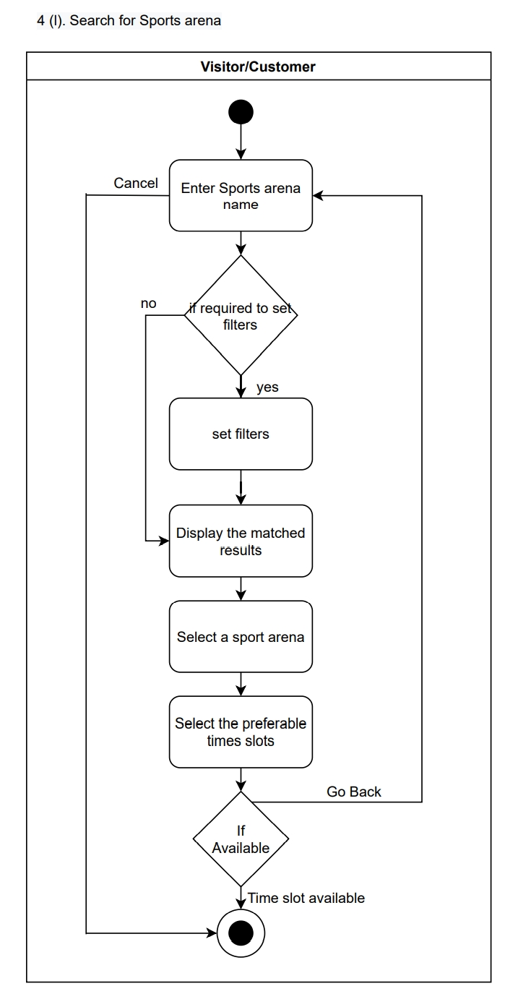
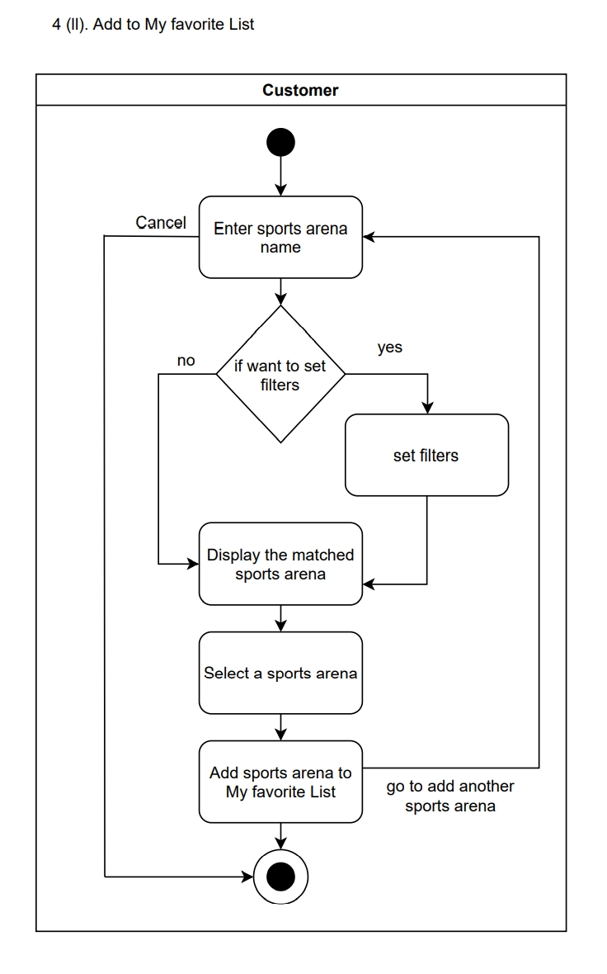
GROUP 19: SPORTIZZA - PROJECT PROPOSAL

Slide 38
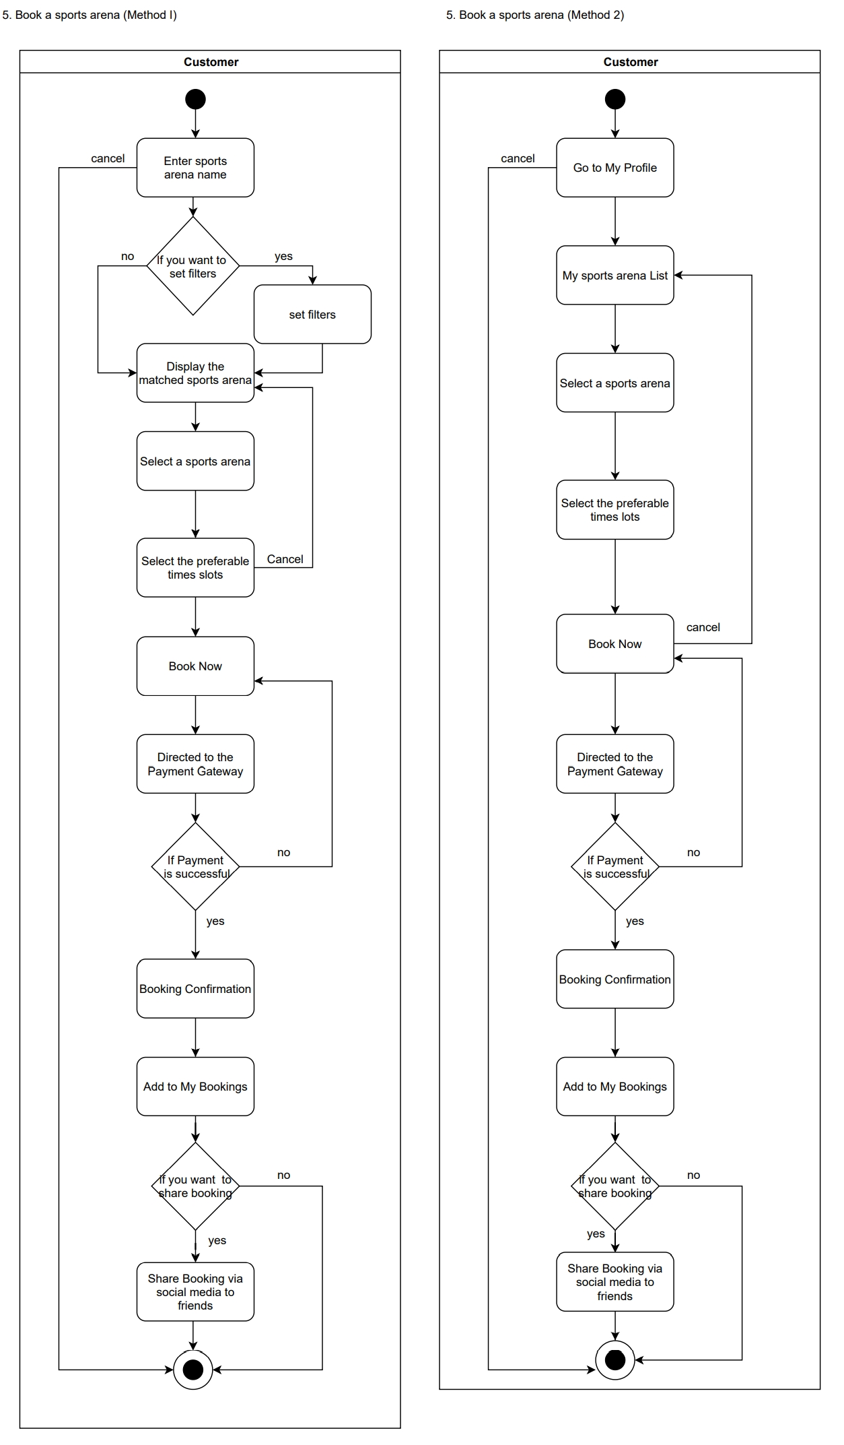
GROUP 19: SPORTIZZA - PROJECT PROPOSAL

Slide 39
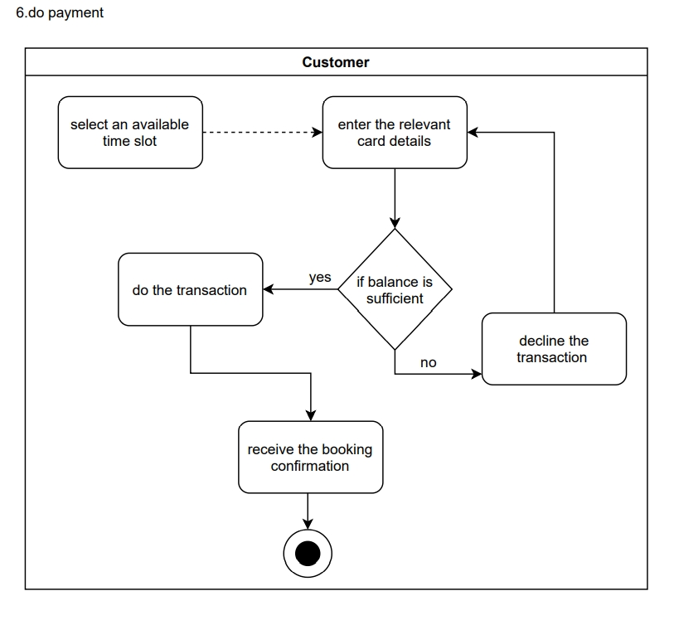
GROUP 19: SPORTIZZA - PROJECT PROPOSAL

Slide 40
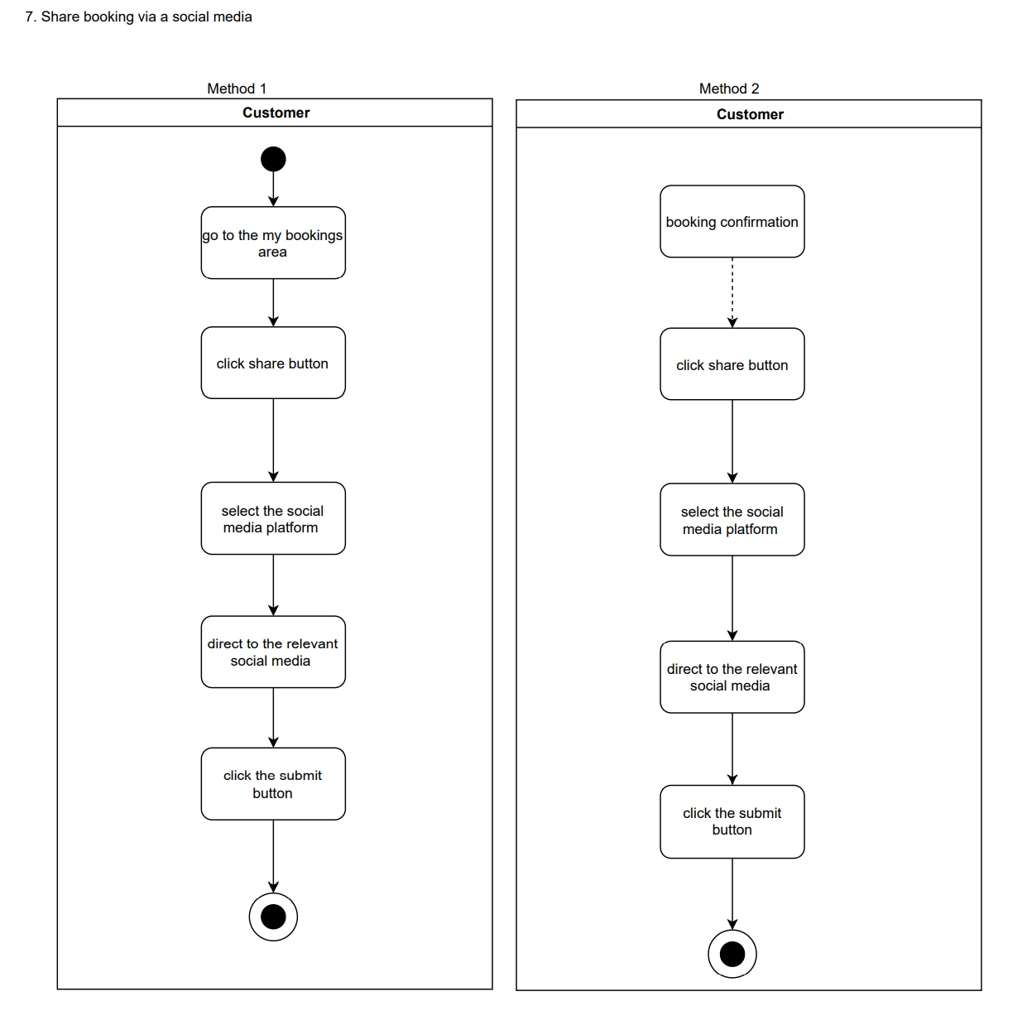
GROUP 19: SPORTIZZA - PROJECT PROPOSAL

Slide 41
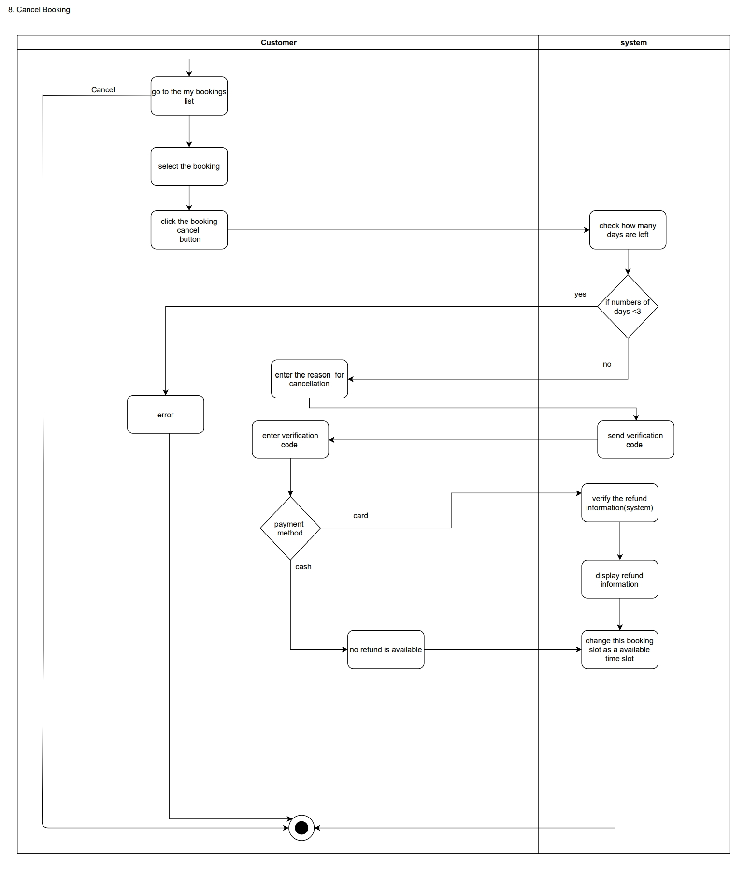
GROUP 19: SPORTIZZA - PROJECT PROPOSAL

Slide 42
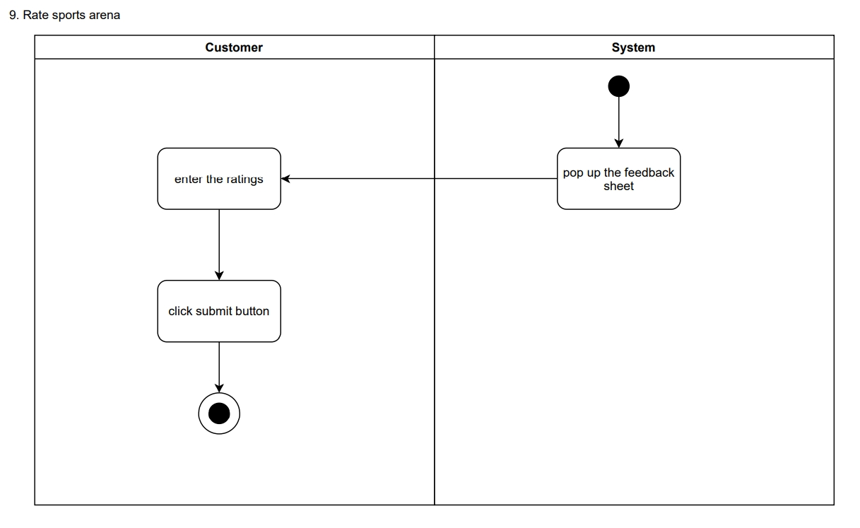
GROUP 19: SPORTIZZA - PROJECT PROPOSAL

Slide 43
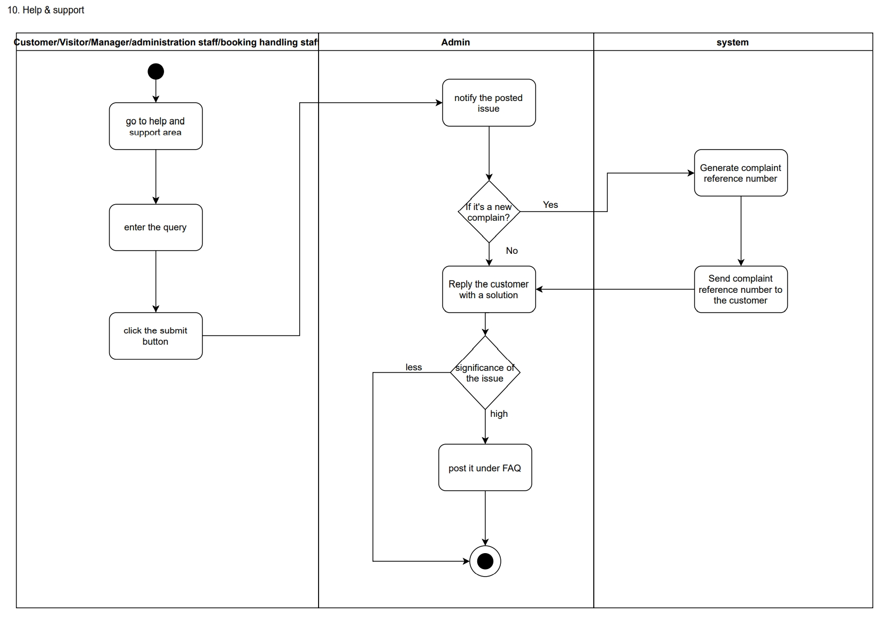
GROUP 19: SPORTIZZA - PROJECT PROPOSAL

Slide 44
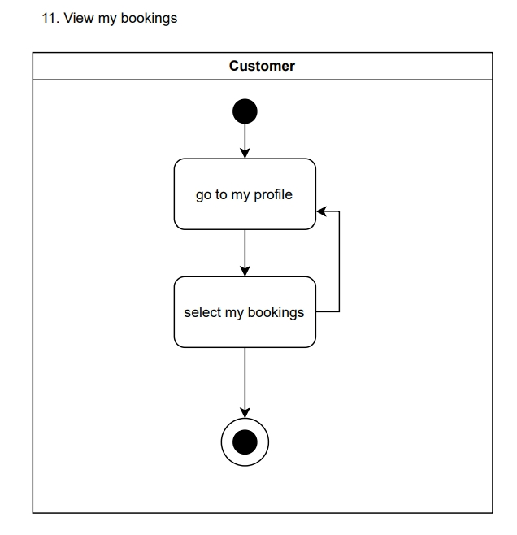
GROUP 19: SPORTIZZA - PROJECT PROPOSAL

Slide 45
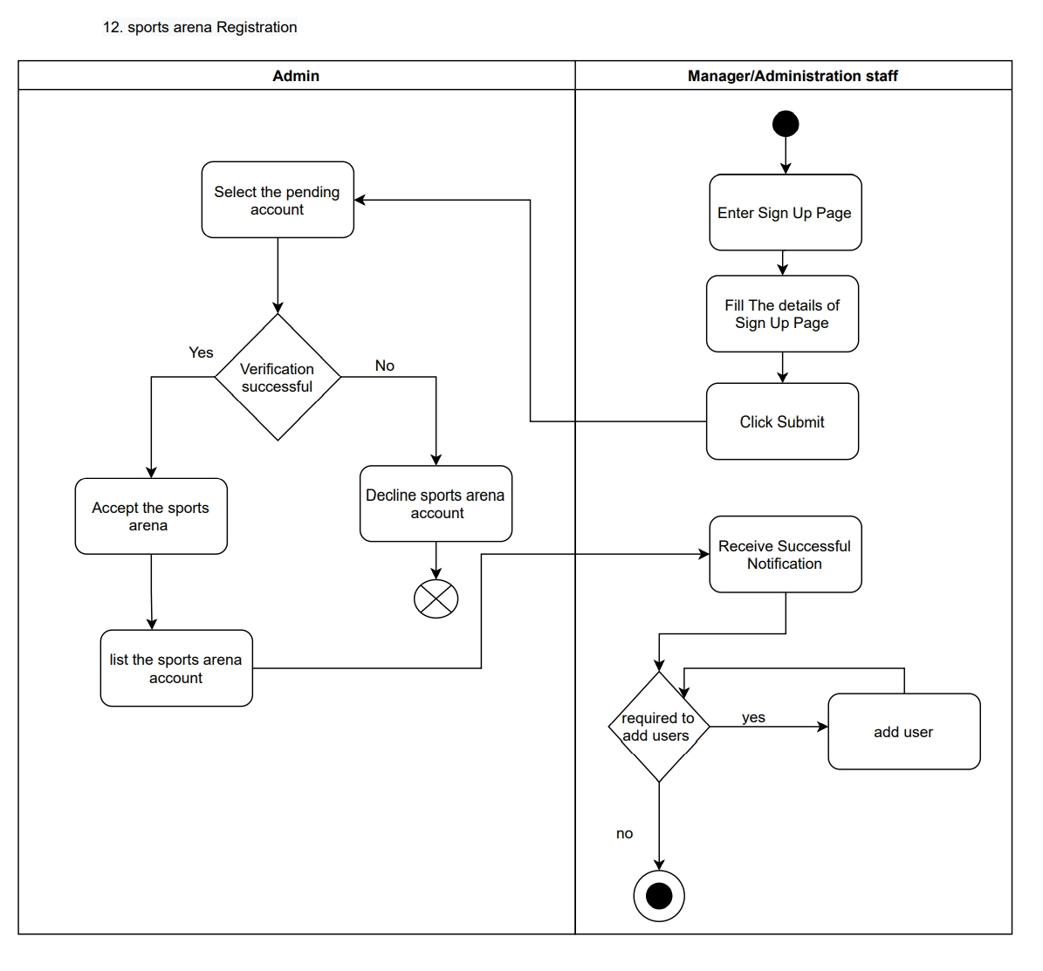
GROUP 19: SPORTIZZA - PROJECT PROPOSAL

Slide 46
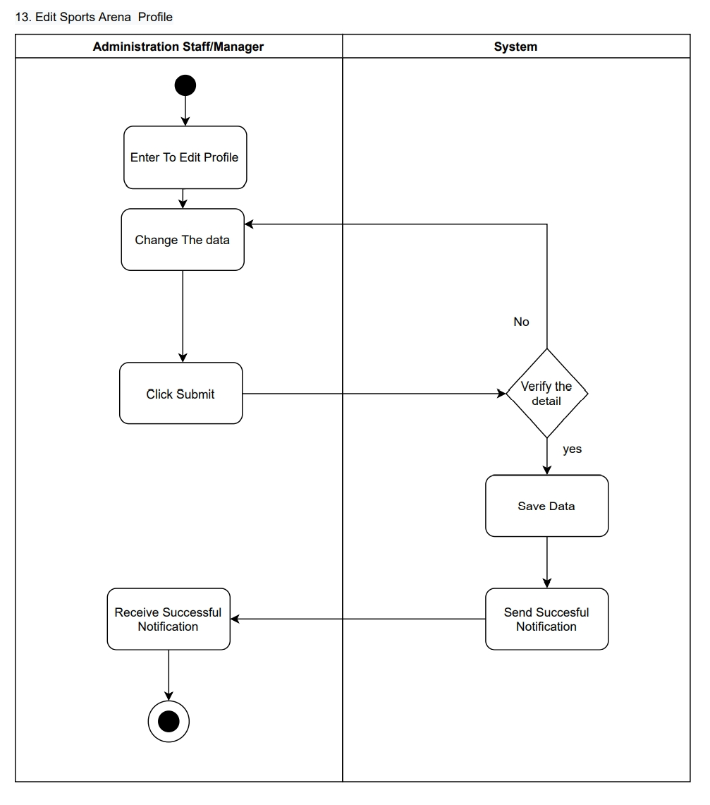
GROUP 19: SPORTIZZA - PROJECT PROPOSAL

Slide 47
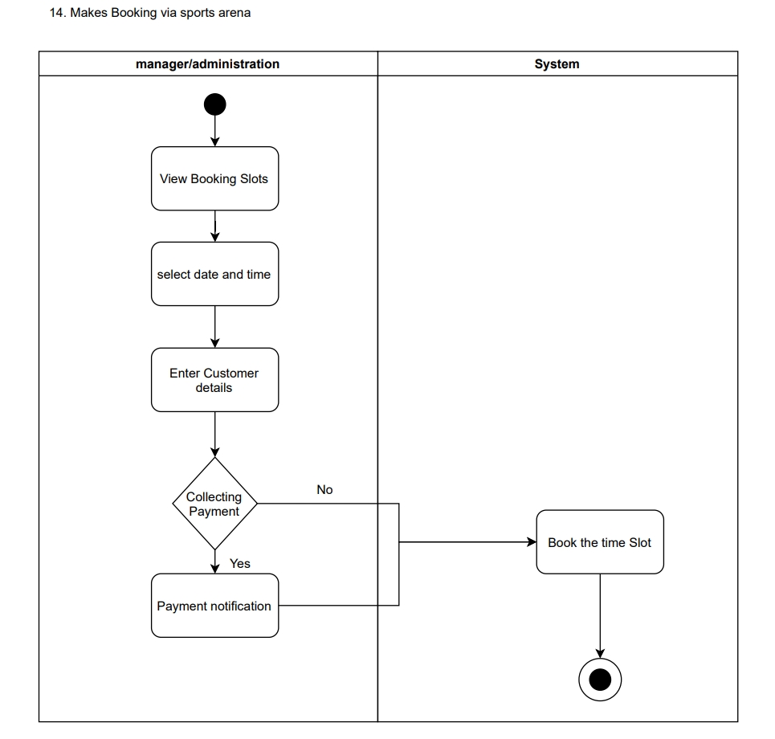
GROUP 19: SPORTIZZA - PROJECT PROPOSAL

Slide 48
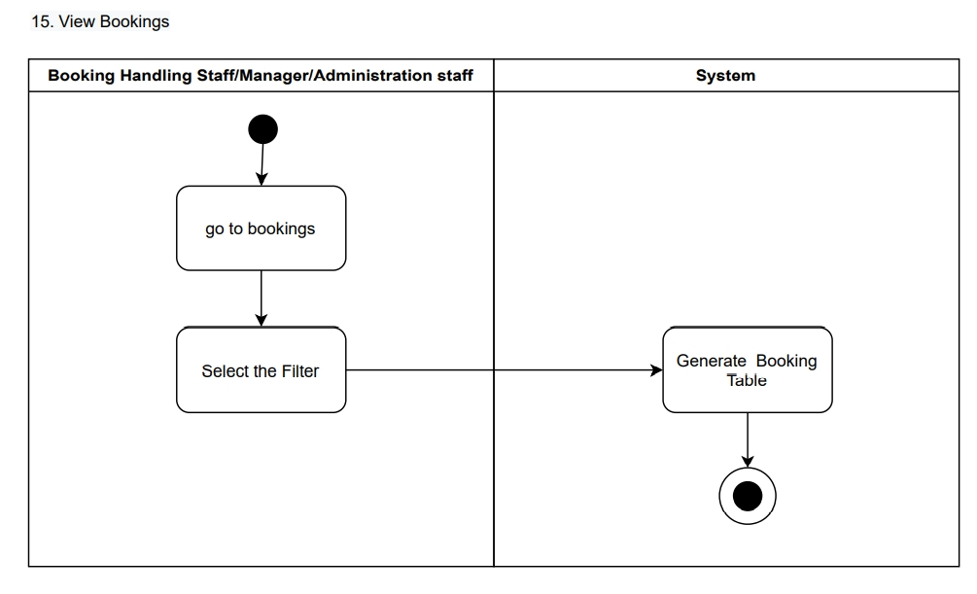
GROUP 19: SPORTIZZA - PROJECT PROPOSAL

Slide 49
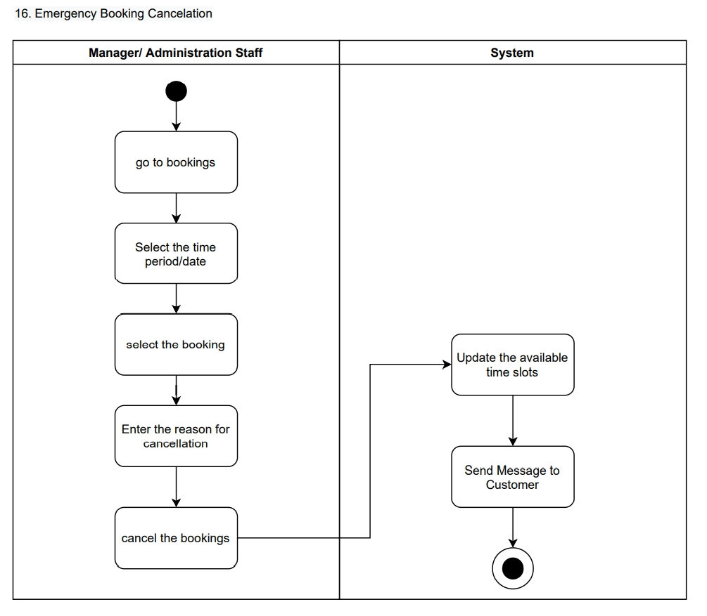
GROUP 19: SPORTIZZA - PROJECT PROPOSAL

Slide 50
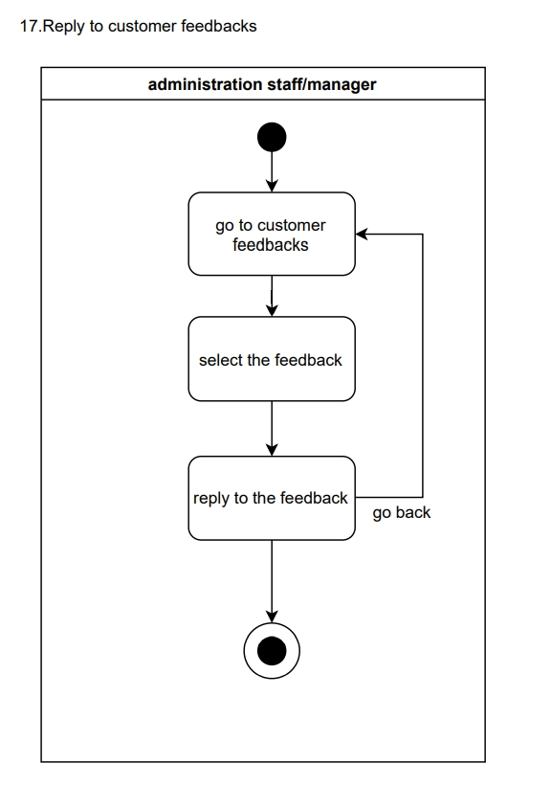
GROUP 19: SPORTIZZA - PROJECT PROPOSAL

Slide 51
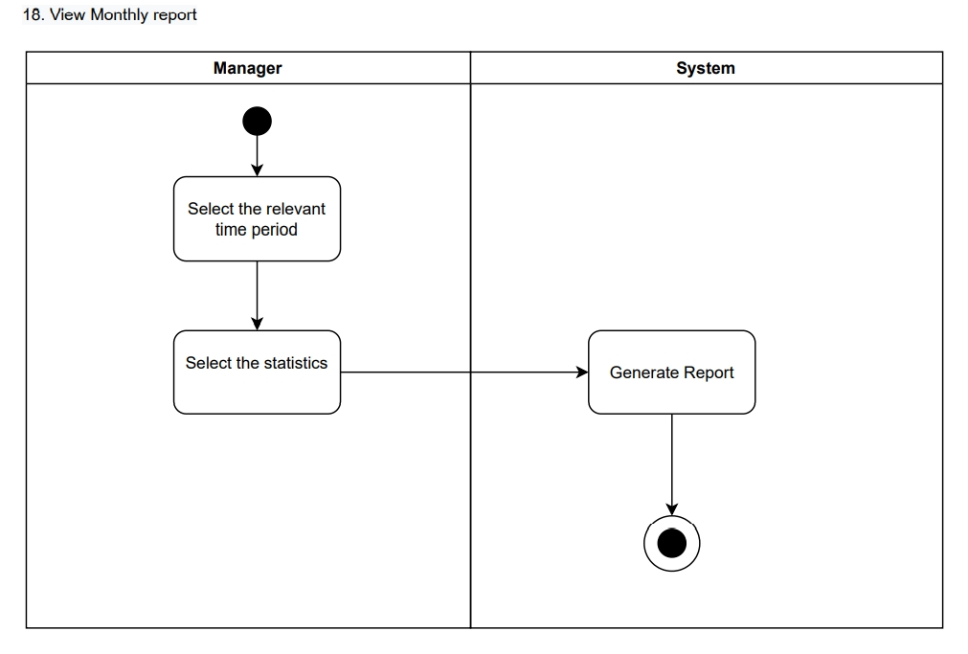
GROUP 19: SPORTIZZA - PROJECT PROPOSAL

Slide 52
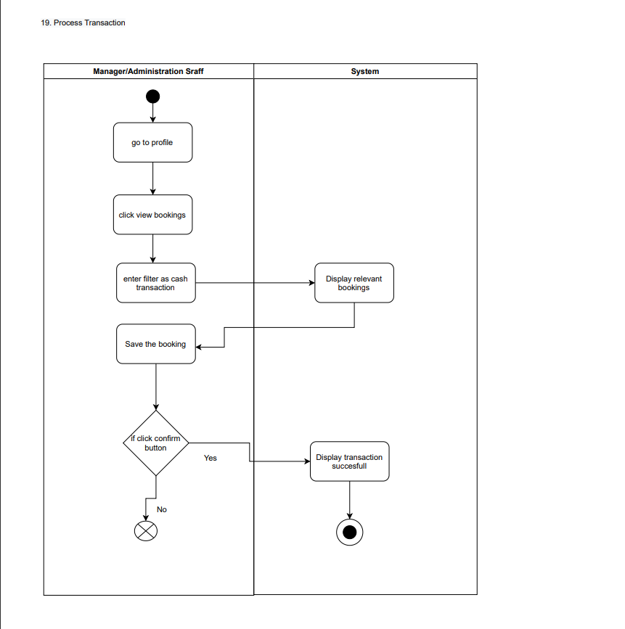
GROUP 19: SPORTIZZA - PROJECT PROPOSAL

Slide 53
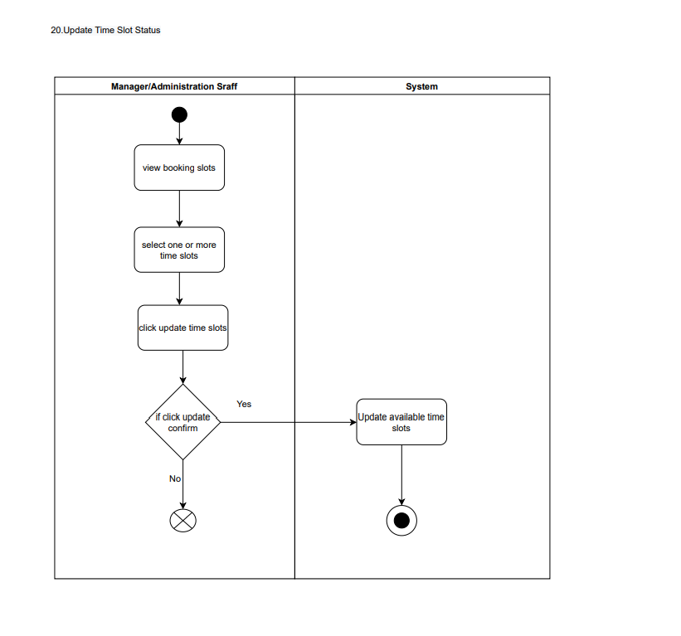
GROUP 19: SPORTIZZA - PROJECT PROPOSAL

Slide 54
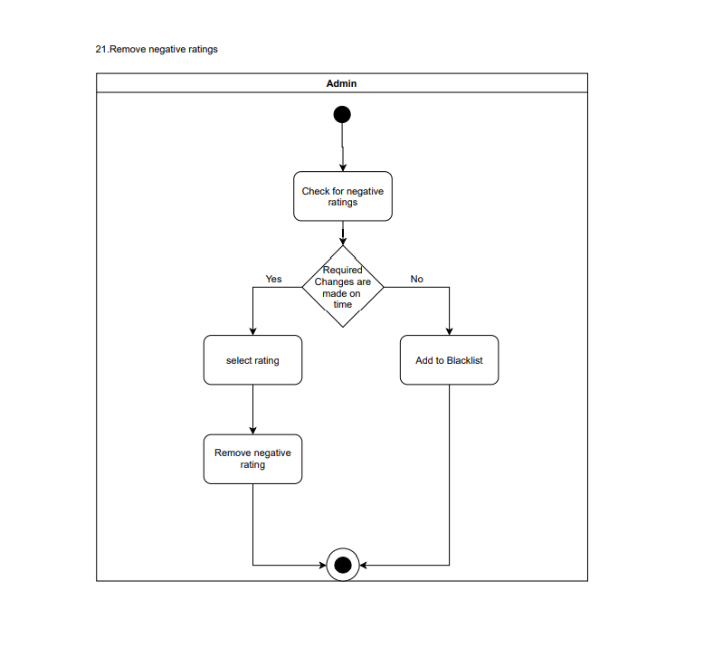
GROUP 19: SPORTIZZA - PROJECT PROPOSAL

Slide 55
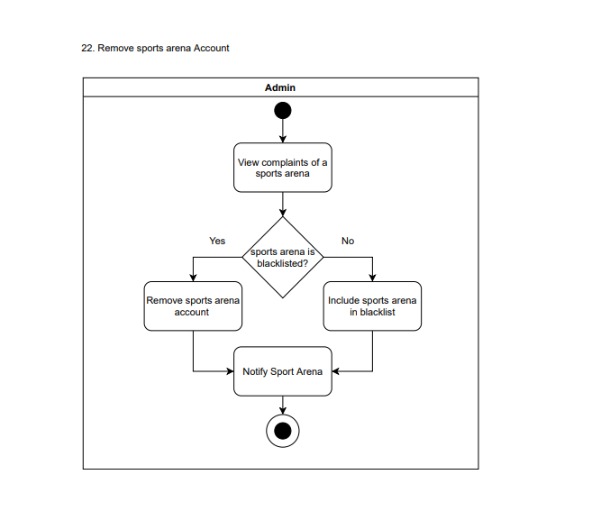
GROUP 19: SPORTIZZA - PROJECT PROPOSAL

Slide 56
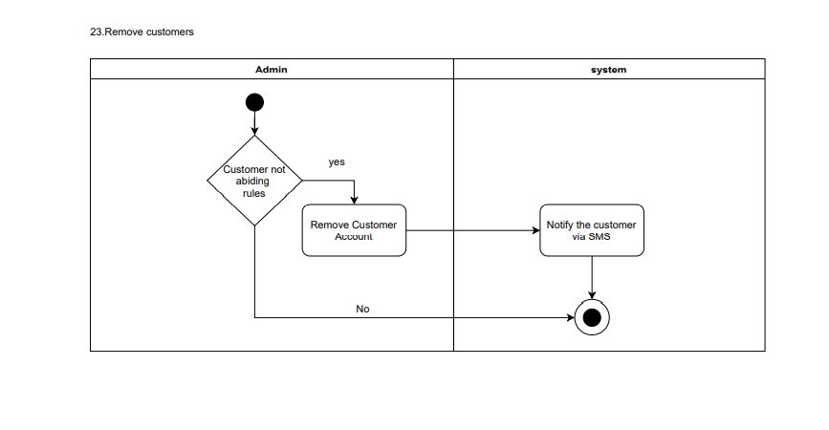
GROUP 19: SPORTIZZA - PROJECT PROPOSAL

Slide 57
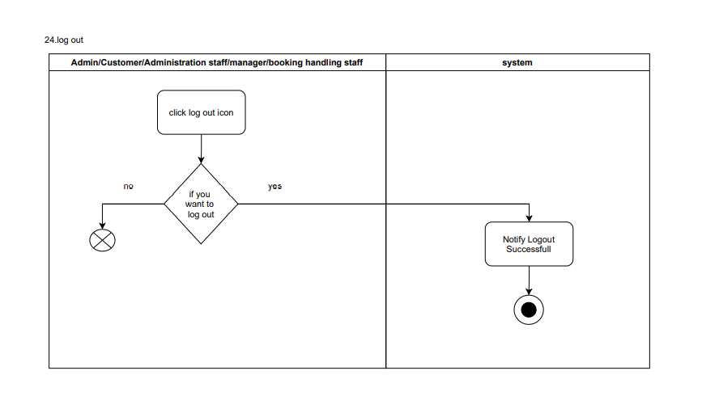
GROUP 19: SPORTIZZA - PROJECT PROPOSAL

Slide 58
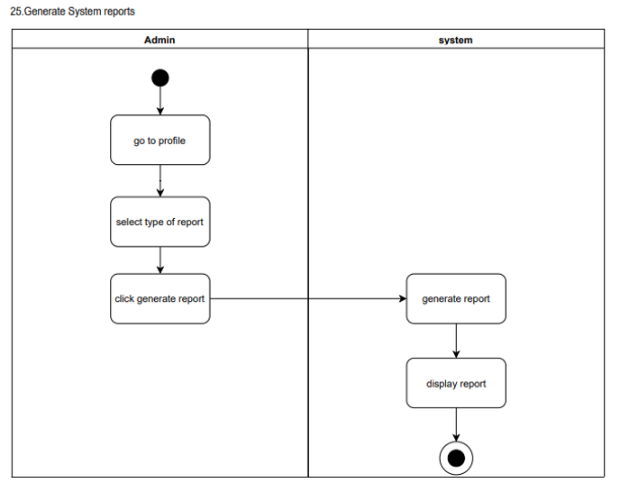
GROUP 19: SPORTIZZA - PROJECT PROPOSAL

Slide 59
Project Proposal Document:
https://drive.google.com/file/d/1dE8byy_5My-FuhortcEVn5mqWAfURTAq/view?usp=sharing
GROUP 19: SPORTIZZA - PROJECT PROPOSAL

